Slide 1
Feature Force
Yashwanth Reddy
John Schultz
Dhruv Gupta
Bhavay Chopra
Jerin Jacob Mathew

Slide 2
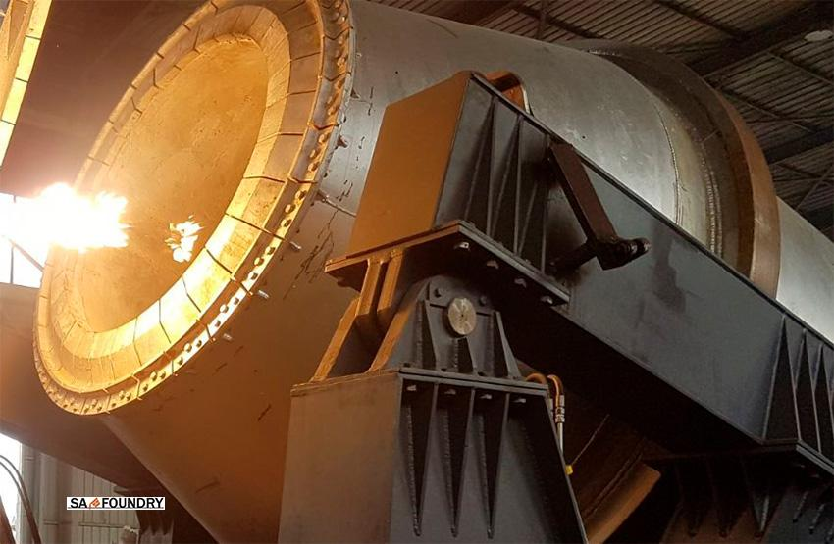
Data Exploration, Cleaning and preprocessing
Rotary Furnace Sensor Data
Removing null values
Data Type conversion
Feature Removal
Regular classification instead of Time series

Slide 3
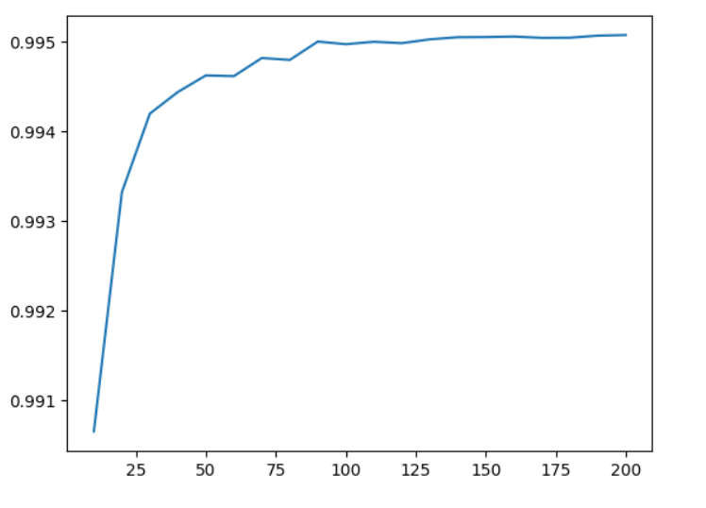
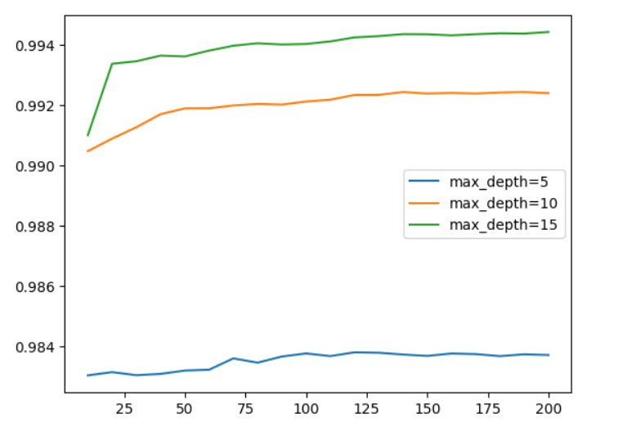
tslearn - The machine learning toolkit for time series analysis in Python

Slide 4
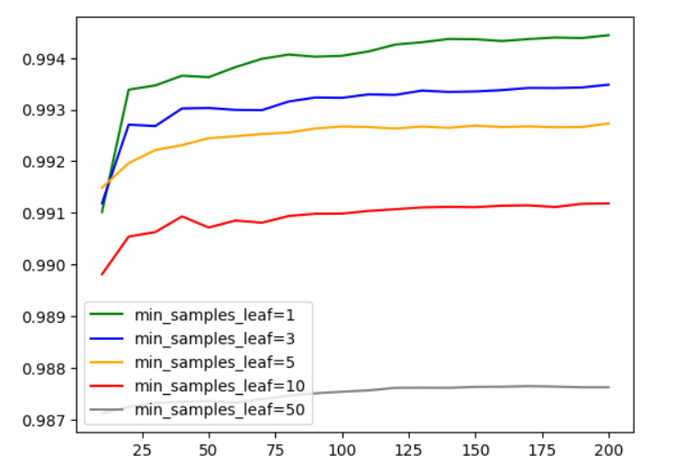
Improved the score by 1.5% after oversampling using SMOTE to solve the imbalance problem.

Slide 5
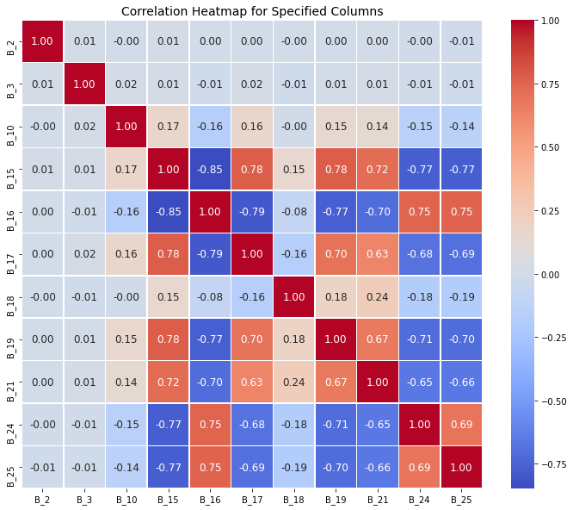
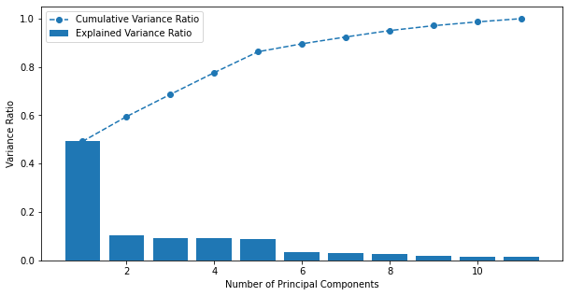
Visualisations

Slide 6
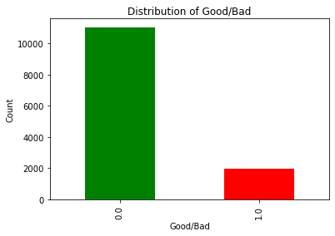
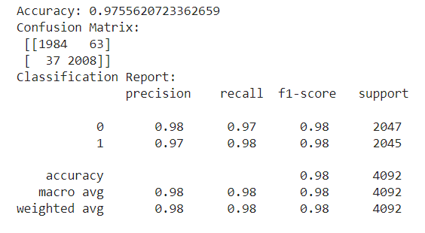

Slide 7
Modeling
Random forest
Hyperparameter tuning
PCA
XG Boost
Oversampling

Slide 8
Conclusion
Multiple approaches and techniques achieve reasonable / high results
Different methods possible to address Data issues (dimensionality, imbalance)
Final best performance no overly complicated model

